Slide 1


Review Meeting
January 2018

Slide 2
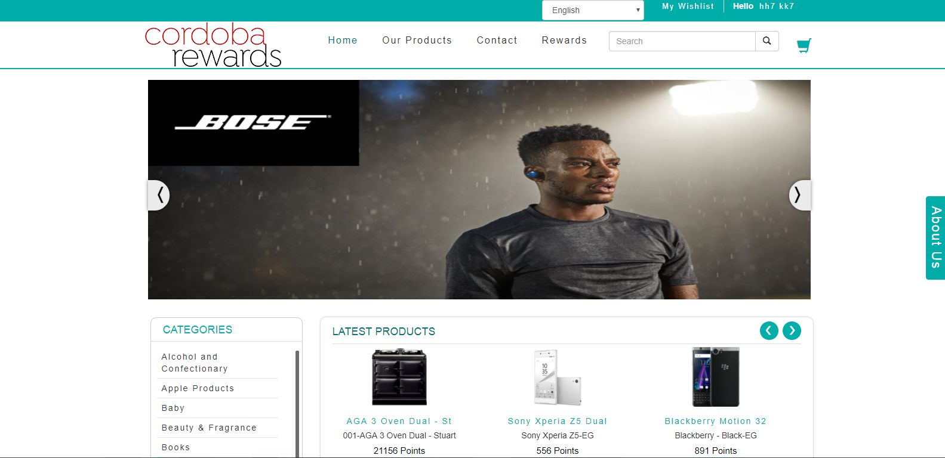
Store

Slide 3
Store Summary

Slide 5
Top Points Holders
FullName | Email | Points | Status | DateAdded
Krupesh Patel | krupesh.p@shaligraminfotech.com | 109871 | Enabled | 9/2/2019
Ruben Pritchard | ruben.pritchard@unipart.com | 5000 | Enabled | 3/9/2018
David Tull | david.tull@chg-meridian.com | 2261 | Enabled | 7/10/2018
Evelyne Belaud | evelyne@airivo.com | 2000 | Enabled | 7/17/2018
Helen Williams | helenwilliams@spbuk.com | 2000 | Enabled | 6/4/2019
test test | nitinp@live.co.uk | 909 | Enabled | 1/15/2018
Jack Miles | jackmiles@cordobagroup.co.uk | 500 | Enabled | 11/9/2017
Robert Eggleston | galanthusconsulting@talktalk.net | 160 | Enabled | 11/22/2017
test test | harsh.k@shaligraminfotech.com | 120 | Enabled | 11/13/2018
Nitin Patel | npatel@satvasoftech.com | 106 | Enabled | 3/6/2017

Slide 8
Order Placed By Type
No Orders Available.

